Slide 1


CTurtleBot – A Turtle Inspired Soft Robot ECE 499
Stephen Zhu
Professor Yang Zhang

Slide 2
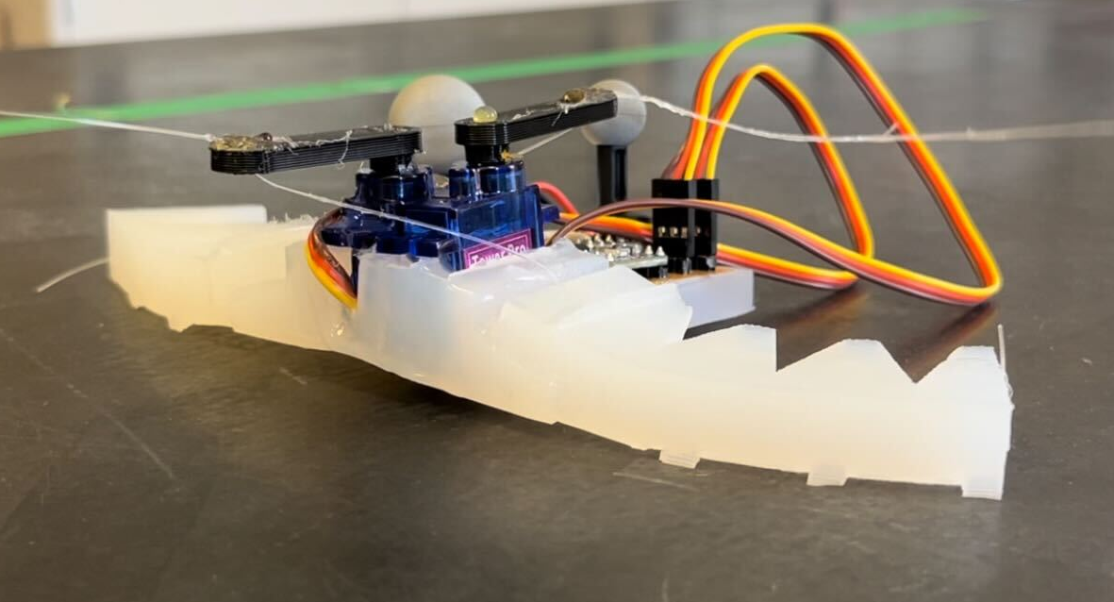
Topic Statement
Motivation:
Investigate human-inaccessible areas
Pipes
Soft vs traditional robots
Compliancy
Inert, self-healing
Goal:
Soft and untethered
Testbed for hysteresis-based control
Inspired from turtle flippers
Image of final prototype

Slide 3
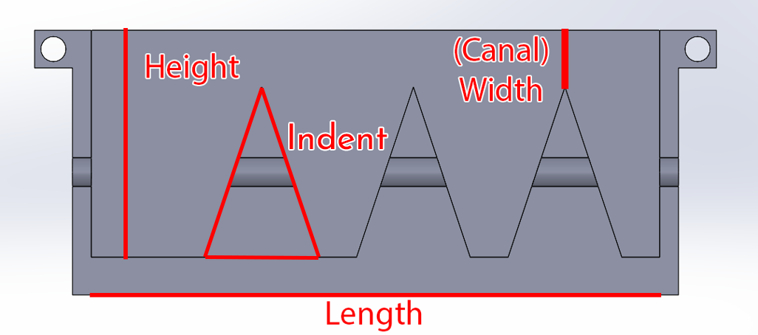
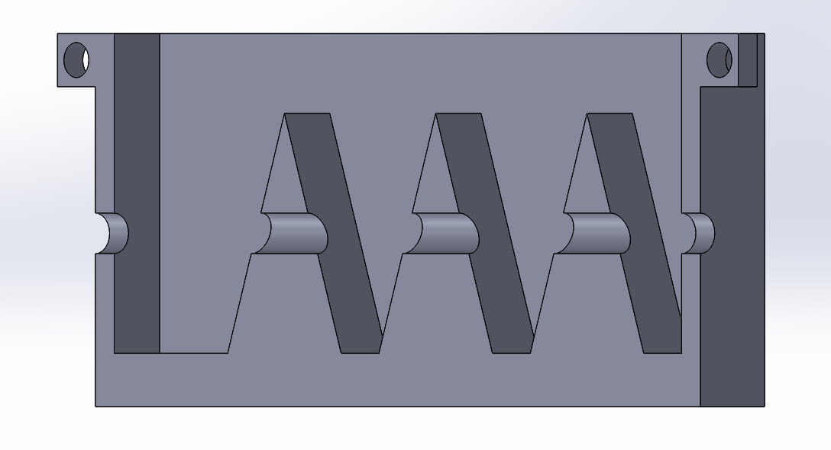
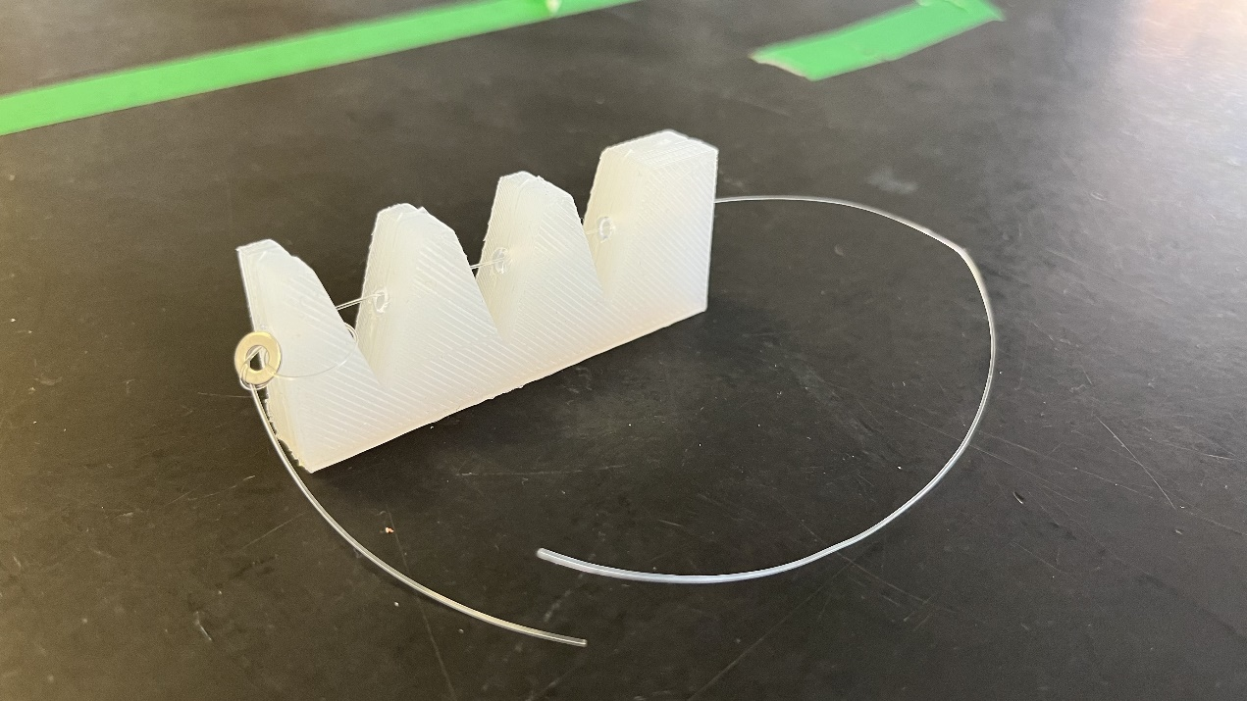
Initial Actuator Design Procedure
Mold
Kept indents and length constant
Height
15 mm vs 30 mm
Width
2.5 mm vs 7.5 mm
Thickness
12 mm vs 25 mm
Materials (Silicone rubbers)
Body Double
Ecoflex 50
Dragon Skin 30
Different views of a half-mold
Fully processed soft actuator

Slide 4
Initial Actuator Design Procedure
Testing
Hold actuator against side of table
Measure how much mass to fully bend
Results:
30 mm tall, 7.5 mm wide, Dragon Skin 30
15 mm tall requires too much force

Slide 5
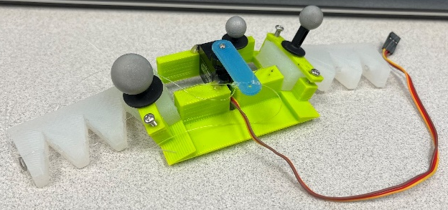
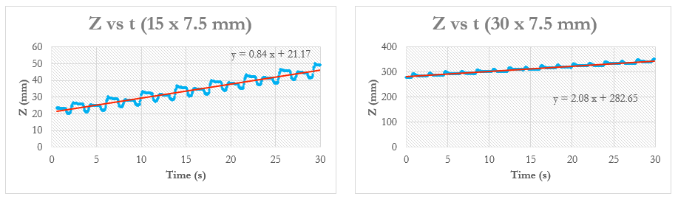
Initial Actuator Design Procedure
3D printed body
Measure performance of actuators
Net velocity of the robot
Motion capture system
Printed body prototype

Slide 6
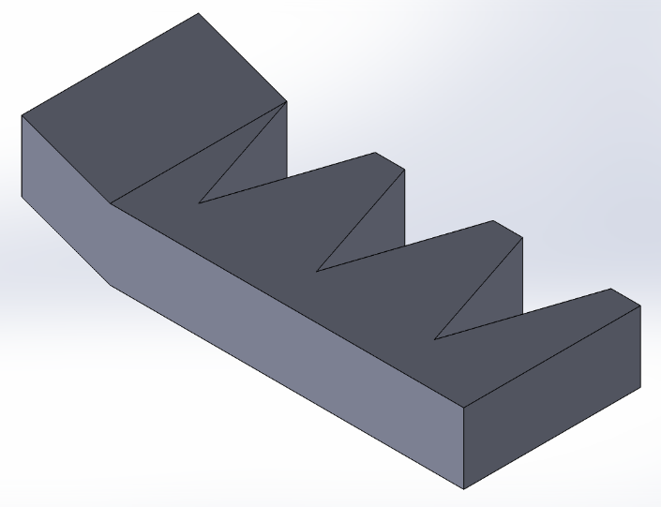
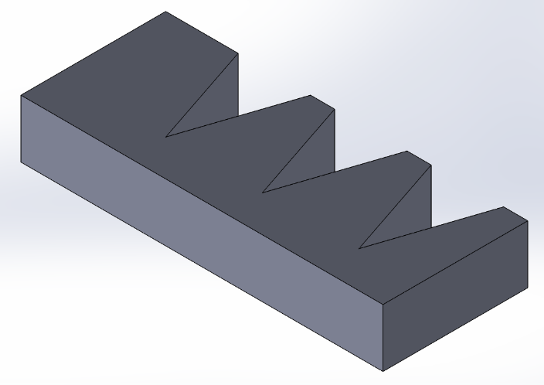
Optimizing the Design
Bending the actuator
Test performance of edge versus surface
Conclusion: bending decreases directional friction
Normal, unbent actuator versus bent actuator design

Slide 7
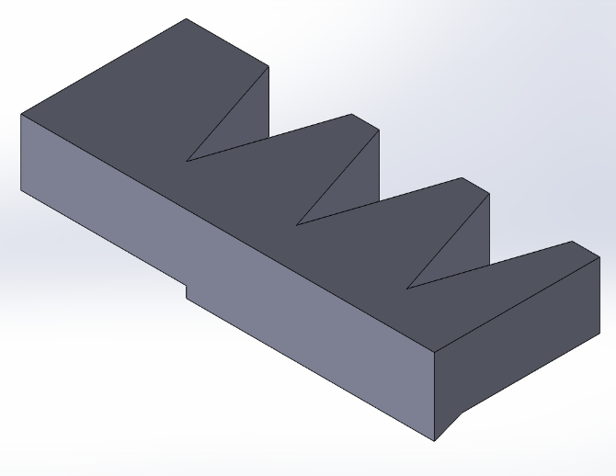
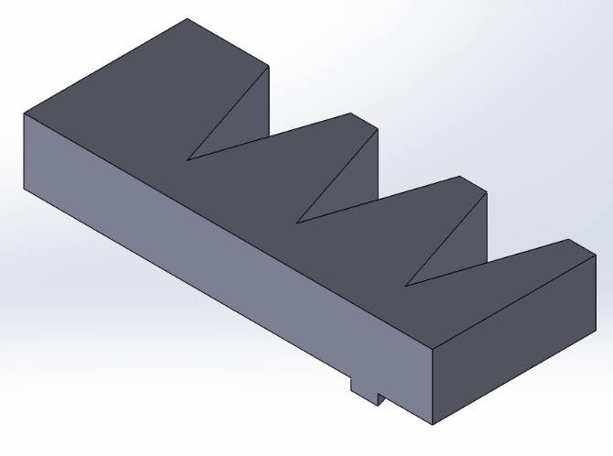
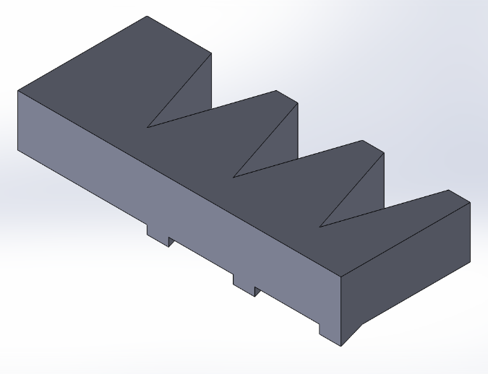
Optimizing the Design
Edge augmentations to increase directional friction
Single large wedge
Single small wedge
Three small wedges
Large wedge, small wedge, and three-wedge designs

Slide 8
Optimizing the Design

Slide 9
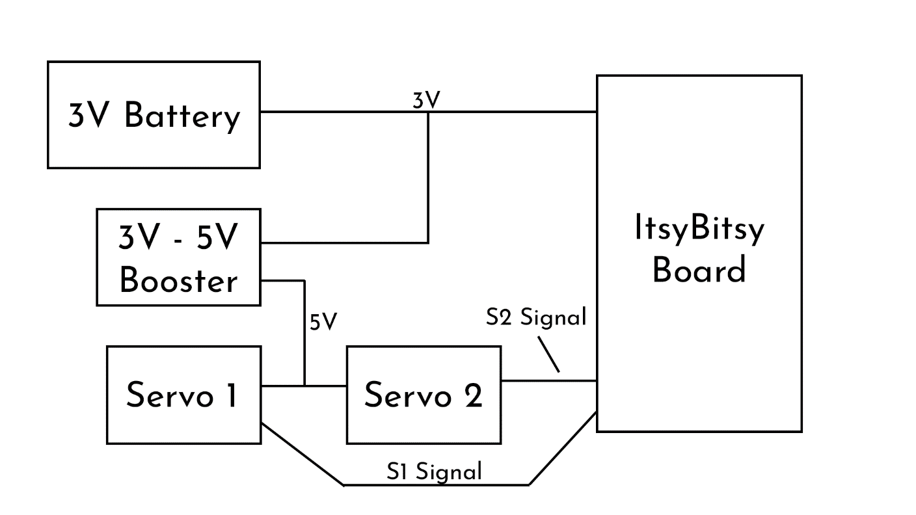
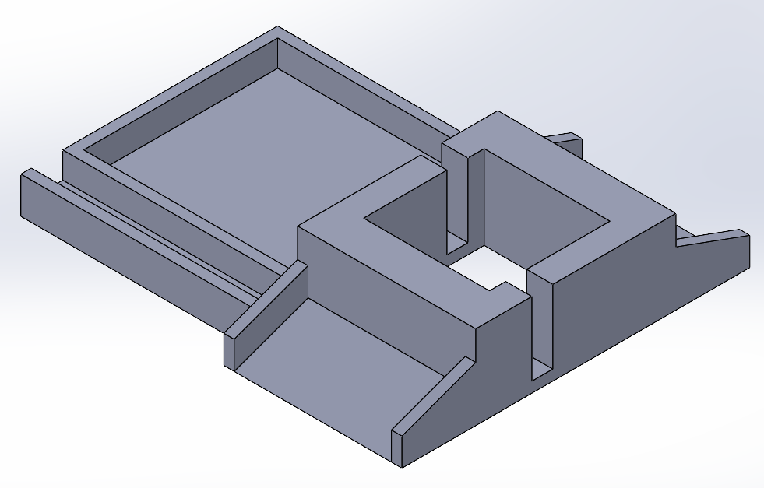
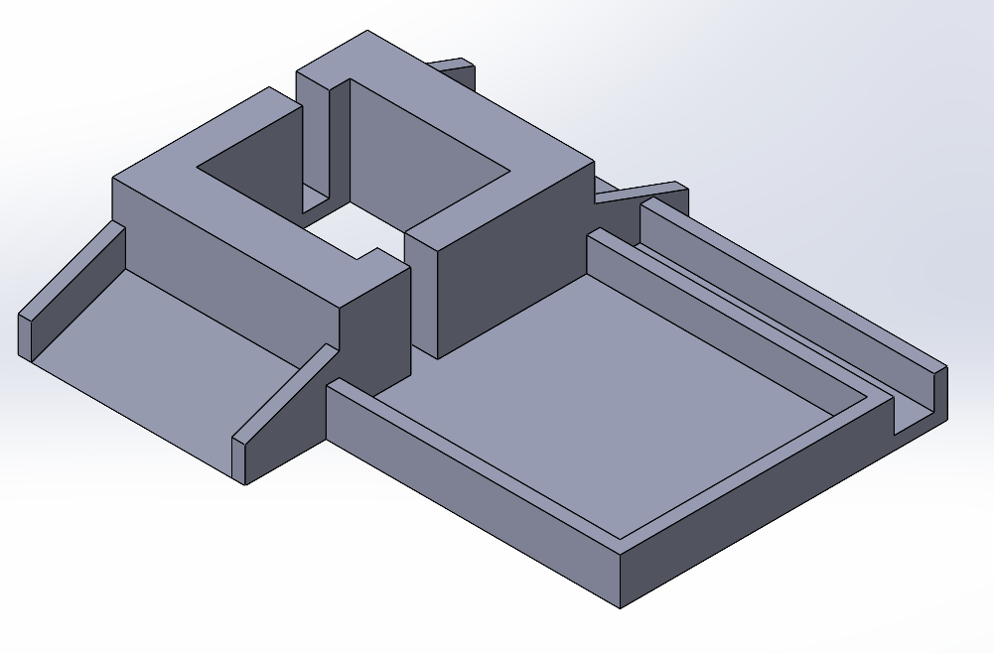
System Integration
Custom PCB
Untethered
Servo
Two instead of one
Increased speed by 5x
Soft body design
Compartments to house PCB and battery
Block diagram of circuit
Front and back view of soft body mold

Slide 10
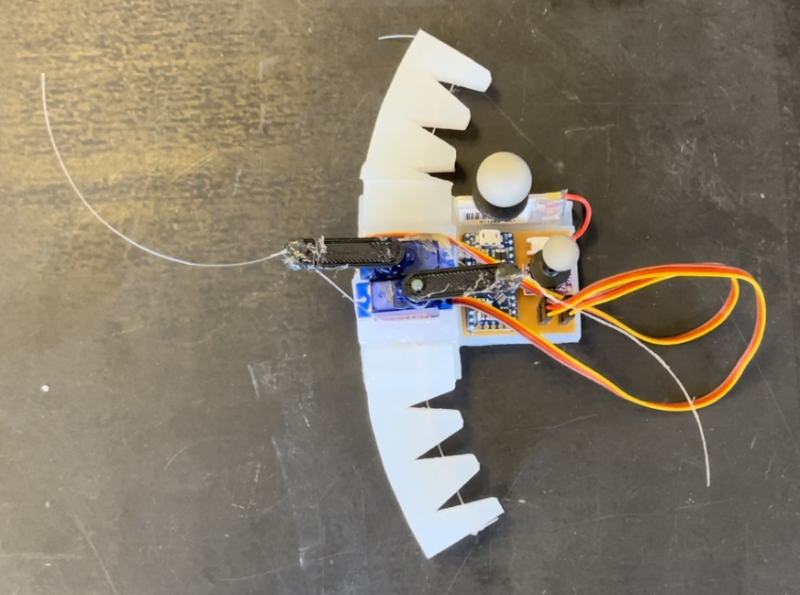
Results
Net robot velocity
4 mm/s
Bird’s eye view of the completed robot

Slide 11
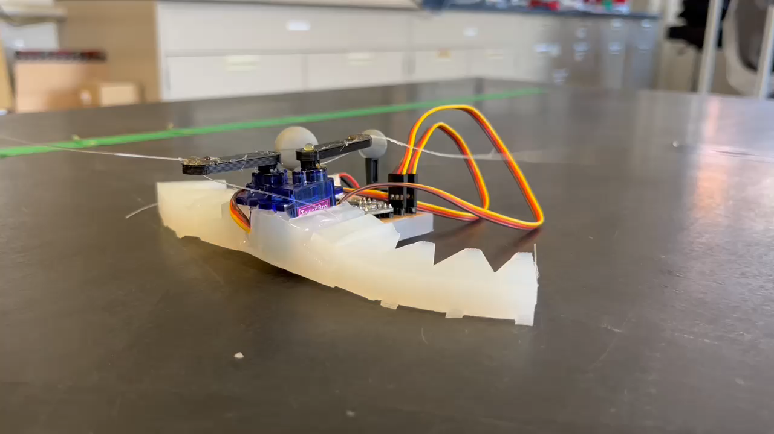
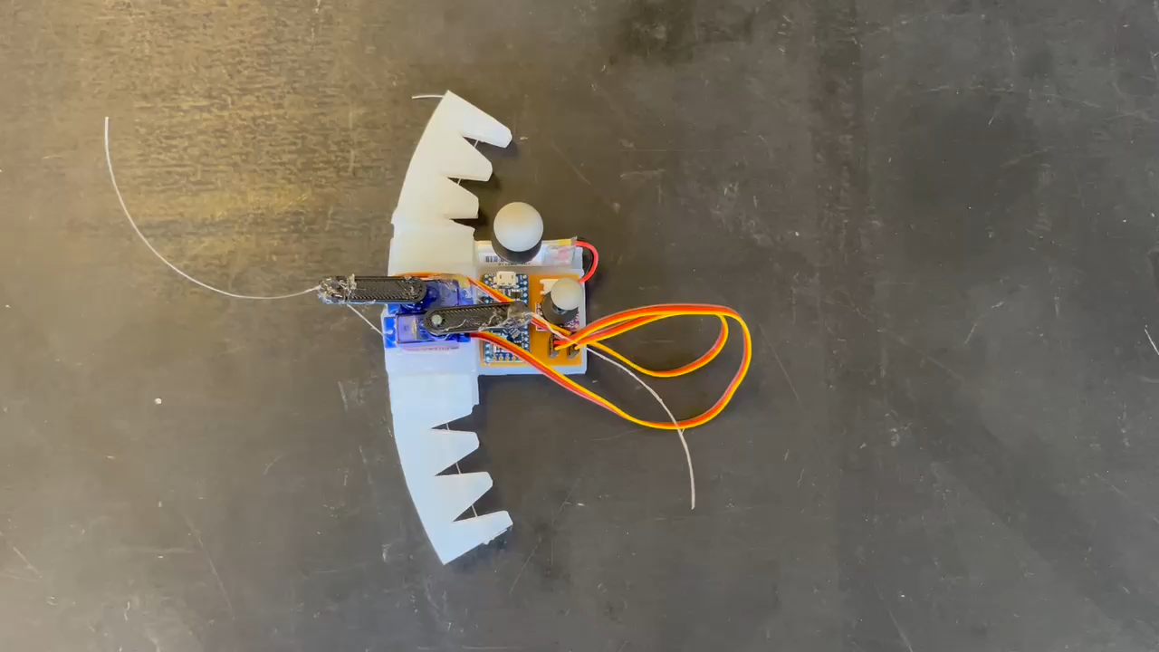
Demonstration

